Slide 1
Chapter 2
NEGATIVITY: The Evil King Goes Hungry

Slide 2
It is impossible to build one’s own happiness on the unhappiness of others.
—Daisaku Ikeda

Slide 3
Cancers of the mind
"Cancers of the mind," referring to comparing, complaining, and criticizing, highlights negative thought patterns that can adversely impact one's mental well-being and relationships.
Comparing: Constantly measuring oneself against others can lead to feelings of inadequacy or superiority. Instead of fostering a positive mindset, it can breed jealousy, low self-esteem, and hinder personal growth. Embracing individuality and focusing on personal progress can be more beneficial.
Complaining: Habitual complaining not only reflects a negative outlook but can also create a toxic environment for oneself and those around. While it's natural to express concerns, constant complaints without seeking solutions can perpetuate a cycle of negativity. Shifting focus towards finding solutions or practicing gratitude can be a healthier approach.
Criticizing: Excessive criticism, whether directed at oneself or others, can erode self-confidence and damage relationships. Constructive feedback is valuable, but relentless criticism can be destructive. Cultivating empathy and understanding can lead to more positive interactions.
Addressing these "cancers of the mind" involves cultivating self-awareness, fostering a positive mindset, and practicing mindfulness. By consciously choosing to replace comparing with self-acceptance, complaining with gratitude, and criticizing with constructive communication, individuals can promote mental well-being and build healthier relationships.

Slide 4
NEGATIVITY IS EVERYWHERE (But don’t play a victim)
Bad things do happen. In our lives, we’re all victims at some point—whether we’re being racially profiled or being cut off in traffic. But if we adopt a victim mentality, we’re more likely to take on a sense of entitlement and to behave selfishly.
Stanford psychologists took 104 subjects and assigned them to one of two groups—one told to write a short essay about a time they were bored, and the other to write about a time when life seemed unfair or when they felt “wronged or slighted by someone.”
Afterward, the participants were asked if they wanted to help the researchers with an easy task. Those who’d written about a time they’d been wronged were 26 percent less likely to help the researchers.
In a similar study, participants who identified with a victim mindset were not only more likely to express selfish attitudes afterward, they were also more likely to leave behind trash and even take the experimenters’ pens!

Slide 5
NEGATIVITY IS CONTAGIOUS (And Groupthink Bias)
In the 1950s Solomon Asch gathered groups of college students and told them they were doing a vision test. The catch was that in each group, everyone was an actor except one person: the subject of the test.
Asch showed participants an image of a “target” line first, then of a series of three lines: one shorter, one longer, and one that was clearly the same length as the target line. The students were asked which line matched the length of the target line. Sometimes the actors gave correct answers, and sometimes they purposefully gave incorrect answers. In each case, the real study participant answered last.
The correct answer should have been obvious. But, influenced by the actors, about 75 percent of the subjects followed the crowd to give an incorrect response at least once. This phenomenon has been called groupthink bias.

Slide 6
Groupthink is the practice of thinking or decision-making in a way that discourages individual responsibility.

Slide 7
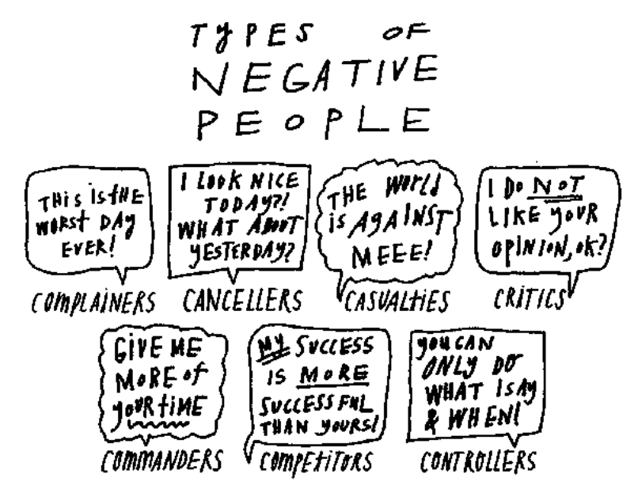

Slide 8
Negative behaviors surround us so constantly that we grow accustomed to them.
Think about whether you have any of the following in your life:
Complainers, like the friend on the phone, who complain endlessly without looking for solutions. Life is a problem that will be hard if not impossible to solve.
Cancellers, who take a compliment and spin it: “You look good today” becomes “You mean I looked bad yesterday?”
Casualties, who think the world is against them and blame their problems on others.
Critics, who judge others for either having a different opinion or not having one, for any choices they’ve made that are different from what the critic would have done.
Commanders, who realize their own limits but pressure others to succeed. They’ll say, “You never have time for me,” even though they’re busy as well.
Competitors, who compare themselves to others, controlling and manipulating to make themselves or their choices look better. They are in so much pain that they want to bring others down. Often we have to play down our successes around these people because we know they can’t appreciate them.
Controllers, who monitor and try to direct how their friends or partners spend time, and with whom, and what choices they make.

Slide 9
Gauranga Das repeated this advice in brief metaphorical form that we often used to remind ourselves not to harbor negative thoughts toward others:
Don’t judge someone with a diﬀerent disease.
Don’t expect anyone to be perfect.
Don’t think you are perfect.

Slide 10
REVERSE EXTERNAL NEGATIVITY
(1) Become an Objective Observer
Instead of reacting compulsively and retaliating to negativity or a negative word or action, we could enjoy our freedom as human beings and refuse to be upset.
We step away, not literally but emotionally, and look at the situation as if we are not in the middle of it. We will talk more about this distance, which is called detachment, in the next chapter.
For now, I’ll say that it helps us find understanding without judgment.

Slide 11
(2) Back Slowly Away
From a position of understanding, we are better equipped to address negative energy. The simplest response is to back slowly away. Just as in the last chapter we let go of the influences that interfered with our values, we want to cleanse ourselves of the negative attitudes that cloud our outlook. In The Heart of the Buddha’s Teaching, Thich Nhat Hanh, a Buddhist monk who has been called the Father of Mindfulness, writes, “Letting go gives us freedom, and freedom is the only condition for happiness. If, in our heart, we still cling to anything—anger, anxiety, or possessions—we cannot be free.” I encourage you to purge or avoid physical triggers of negative thoughts and feelings, like that sweatshirt your ex gave you or the coffee shop where you always run into a former friend. If you don’t let go physically, you won’t let go emotionally.

Slide 12
The 25/75 Principle
Aim for the feeling that at least 75 percent of your time is spent with people who inspire you rather than bring you down.
Allocate Time
There might be some people you can only tolerate for an hour a month, some for a day, some for a week. Maybe you even know a one-minute person. Consider how much time is best for you to spend with them, and don’t exceed it.
Don’t Be a Savior
If all someone needs is an ear, you can listen without exerting much energy. If we try to be problem-solvers, then we become frustrated when people don’t take our brilliant advice. The desire to save others is ego-driven. Don’t let your own needs shape your response.

Slide 13
REVERSE INTERNAL NEGATIVITY
The more we define ourselves in relation to the people around us, the more lost we are.
Spot, Stop, Swap
First, we become aware of a feeling or issue—we spot it.
Then we pause to address what the feeling is and where it comes from—we stop to consider it.
And last, we amend our behavior—we swap in a new way of processing the moment.

Slide 14
Spot
TRY THIS: AUDIT YOUR NEGATIVE COMMENTS.
Keep a tally of the negative remarks you make over the course of a week. See if you can
make your daily number go down. The goal is zero.
Stop
Regarding negative speech...
“Remember, saying whatever we want, whenever we want, however we want, is not freedom. Real freedom is not feeling the need to say these things.”
Swap
Mudita is the principle of taking sympathetic or unselfish joy in the good fortune of others.

Slide 15
KSAMĀ: AMENDING ANGER
Kṣamā is Sanskrit for forgiveness. It suggests that you bring patience and forbearance to your dealings with others. Sometimes we have been wounded so deeply that we can’t imagine how we might forgive the person who hurt us. But, contrary to what most of us believe, forgiveness is primarily an action we take within ourselves. Sometimes it’s better (and safer and healthier) not to have direct contact with the person at all; other times, the person who hurt us is no longer around to be forgiven directly. But those factors don’t impede forgiveness because it is, first and foremost, internal. It frees you from anger.

Slide 16
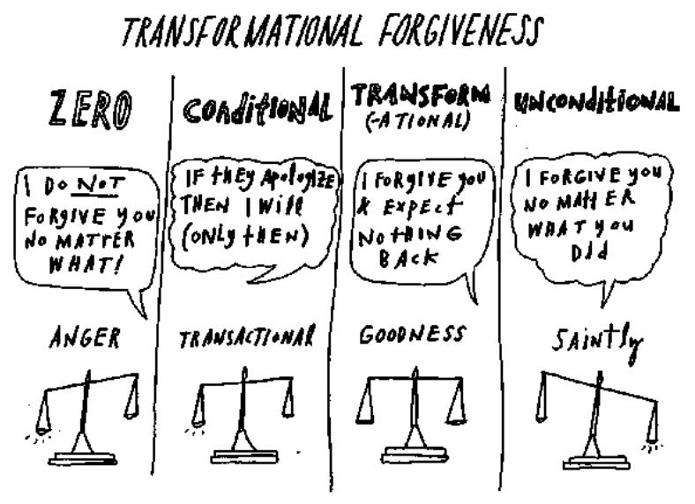
TRANSFORMATIONAL FORGIVENESS

Slide 17
FORGIVENESS IS A TWO-WAY STREET
Forgiveness has to ow in both directions. None of us is perfect, and though there will be situations where you are blameless, there are also times when there are missteps on both sides of a conflict. When you cause pain and others cause you pain, it’s as if your hearts get twisted together into an uncomfortable knot. When we forgive, we start to separate our pain from theirs and to heal ourselves emotionally. But when we ask for forgiveness at the same time, we untwist together. This is a bit trickier, because we’re much more comfortable finding fault in other people and then forgiving it. We’re not used to admitting fault and taking responsibility for what we create in our lives.
On an end note: The less time you fixate on everyone else, the more time you have to focus on yourself.

